Slide 1
Non-REST (SOAP) Web Services
Srikanth Gunturu
Guest Faculty
BITS, WILP

Slide 2
In this segment
Non-REST (SOAP) Web Services
Overview
SOAP Messaging Protocol
Web Services Description Language (WSDL)
Java API for XML Web Services (JAX-WS)

Slide 3
Non-REST (SOAP) Web Services
Overview
First version of web services – released in late ‘90s
Implemented as arbitrary web services grouped together based on business context
Analogous to functional services – focus on functionality
Use SOAP (Simple Object Access Protocol) for data transfer over HTTP/S
Has embedded security via WS-Security header
Supports XML (SOAP is a restricted version of XML)

Slide 4
Non-REST (SOAP) Web Services
SOAP Message Protocol - Overview
Transfers structured information in the form of XML documents
SOAP message is bound to the underlying protocol (mostly HTTP)
SOAP 1.1 – HTTP POST only
SOAP 1.2 (via web methods) – HTTP GET/POST/DELETE
SOAP message goes from sender to receiver via intermediary nodes (SOAP nodes)
SOAP nodes may process SOAP headers and body or may add some additional headers for QoS / Security
SOAP Message exchange patterns
Request-Reply
Response-only

Slide 5
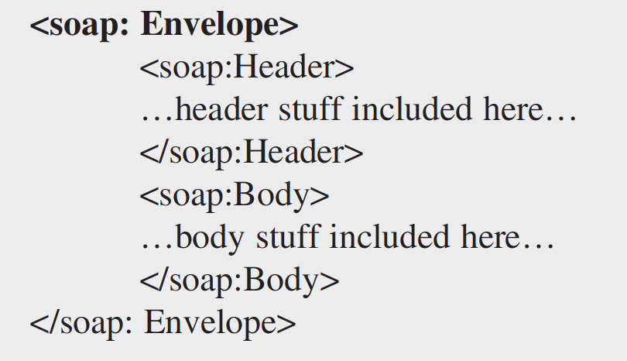

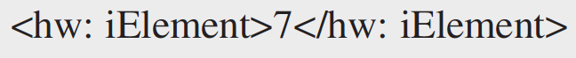
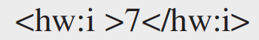
Non-REST (SOAP) Web Services
SOAP Message
SOAP message is enclosed in SOAP envelope
Header is optional, Body is mandatory
Envelope will specify namespace used
SOAP 1.1 – “xmlns:soap=http://schemas.xmlsoap.org/soap/envelope”
SOAP 1.2 – “xmlns:soap=http://www.w3.org/2003/05/soap-envelope”
Encoding
SOAP Encoding – uses SOAP defined XML schema
Literal Encoding – uses XML schema (recommended)
Message Styles
RPC – SOAP Encoded
RPC – Literal
Document - Literal
Document – Literal Wrapped

Slide 6
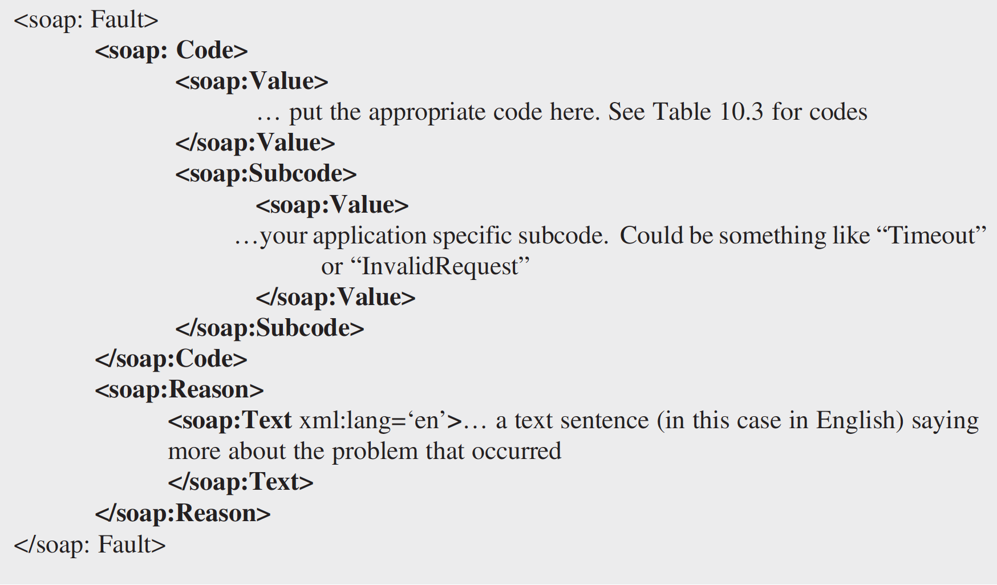
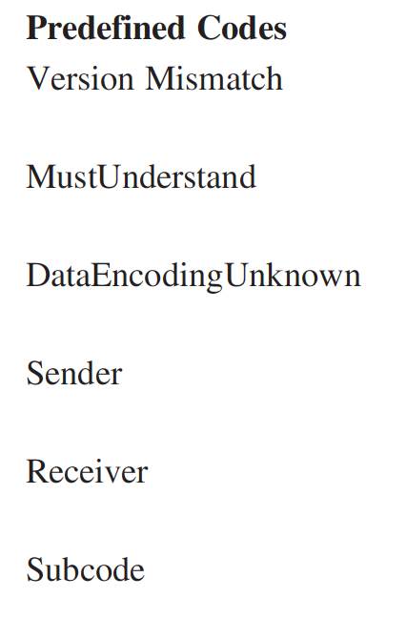
Non-REST (SOAP) Web Services
SOAP Fault
SOAP Fault – Contains error messages generated in processing

Slide 7
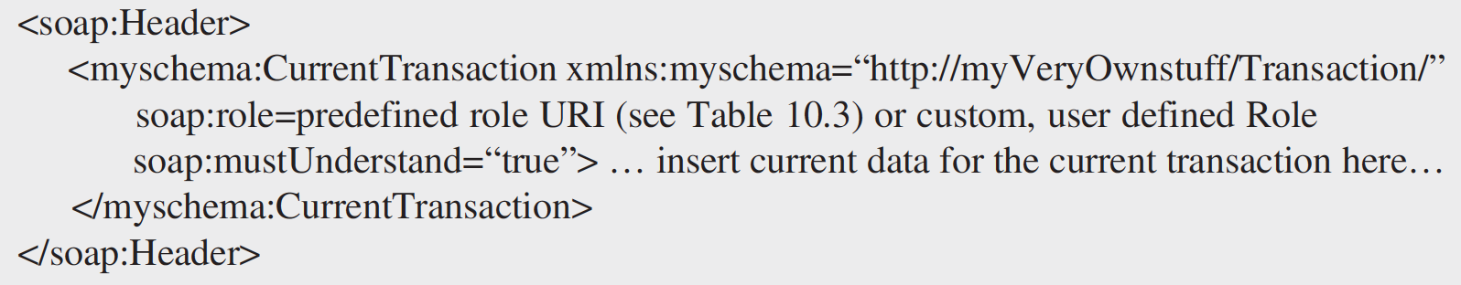
Non-REST (SOAP) Web Services
SOAP Header
SOAP Header – Attributes
mustUnderstand
Role
Relay

Slide 8
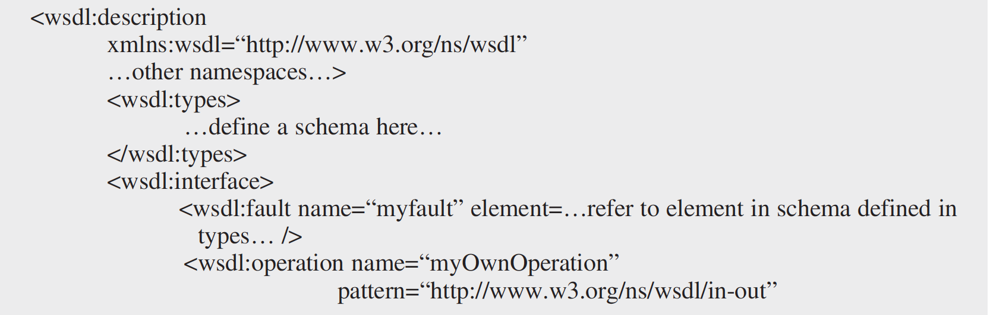
Non-REST (SOAP) Web Services
Web Services Description Language (WSDL)
A language for describing interfaces to web services
Specified in XML format
Message Exchange Patterns:
In-only, Robust In-Only
In-Optional-Out, In-Out, Out-In
Out-only, Robust Out-Only

Slide 9
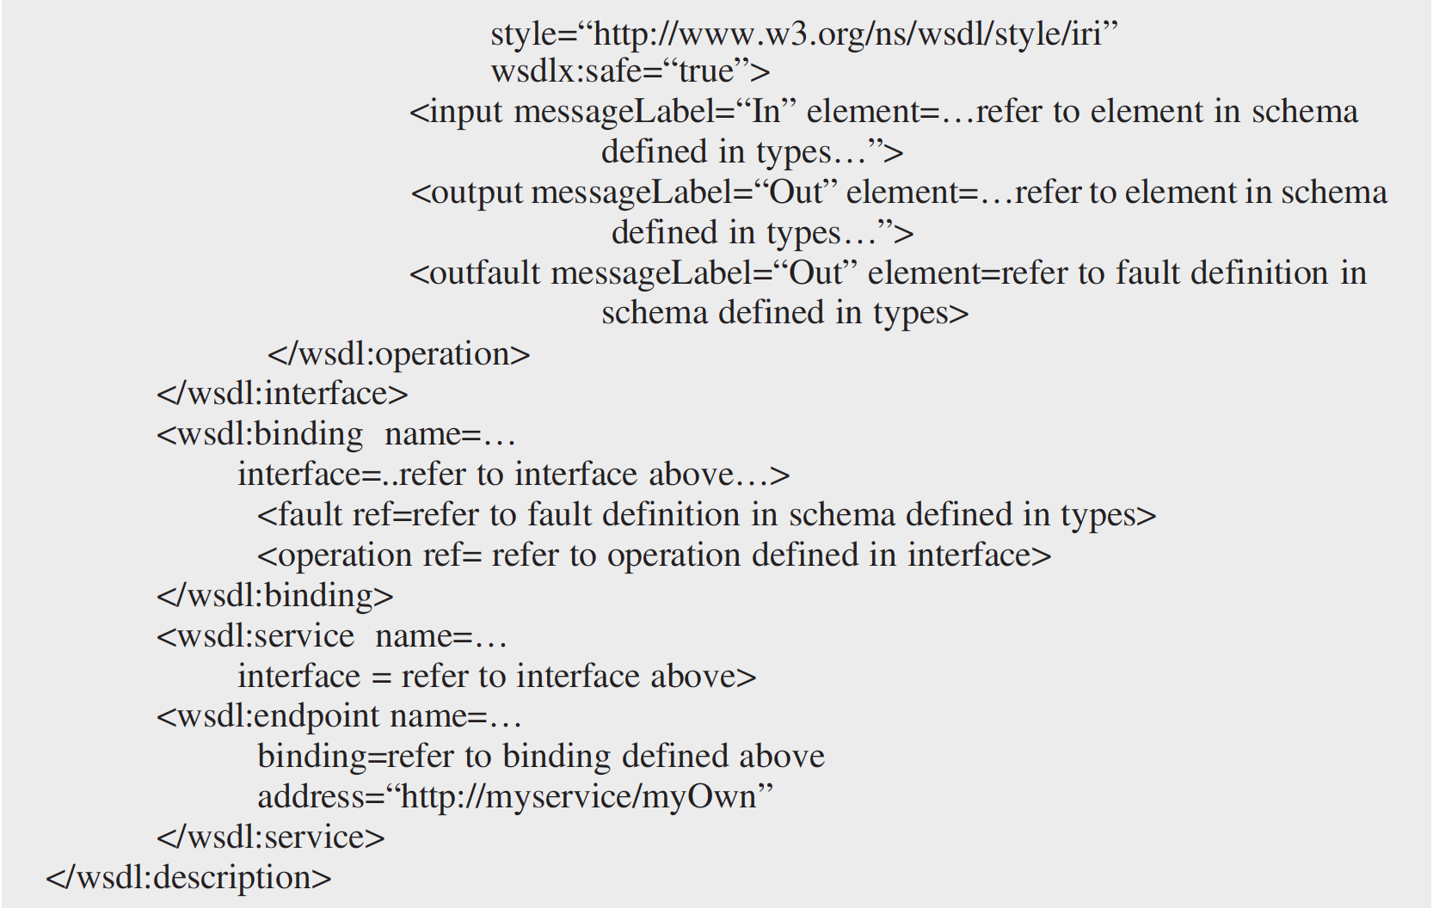
Non-REST (SOAP) Web Services
Web Services Description Language (WSDL) – contd.

Slide 10
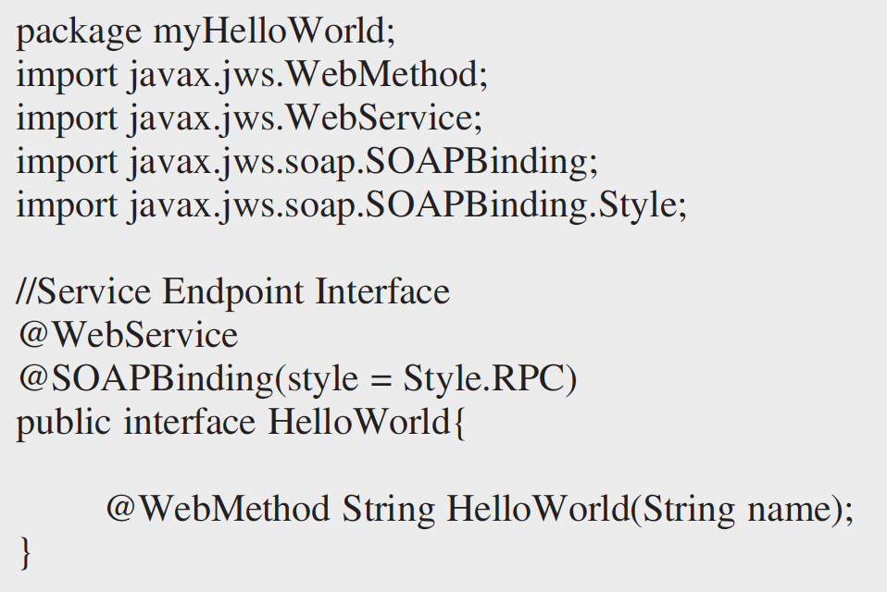
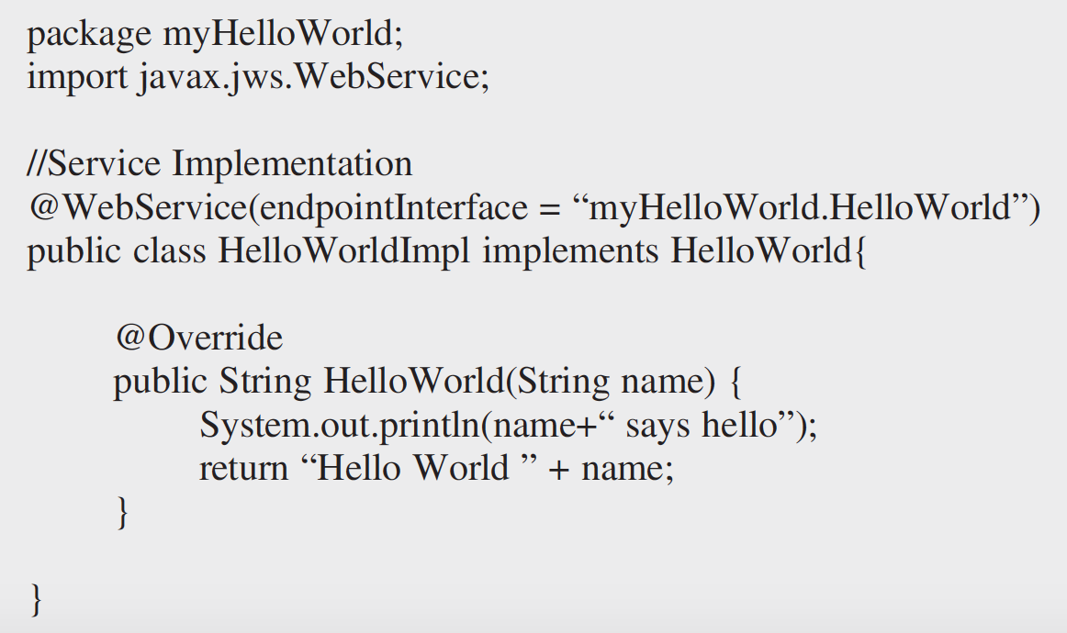
Non-REST (SOAP) Web Services
JAVA API FOR XML WEB SERVICES (JAX-WS)
Java API for creating SOAP web services, part of Java EE
Server side code

Slide 11
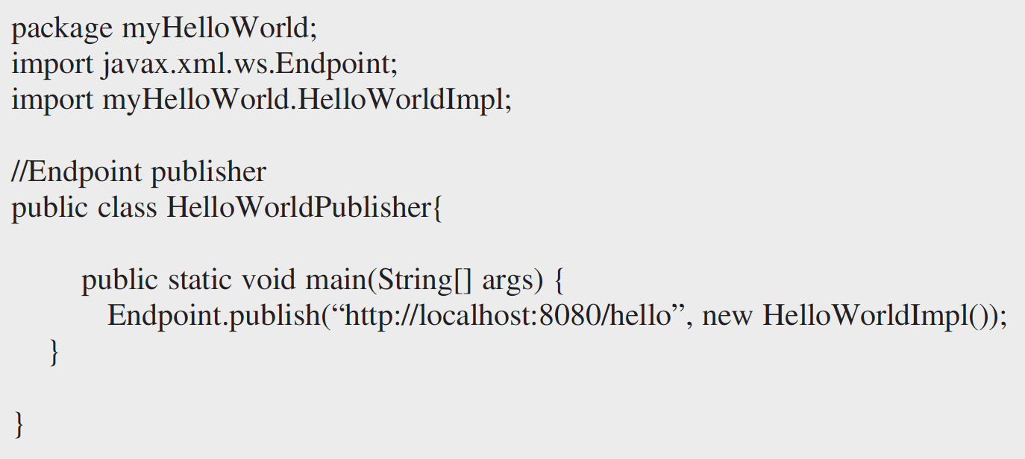
Non-REST (SOAP) Web Services
JAVA API FOR XML WEB SERVICES (JAX-WS)
Service publisher

Slide 12
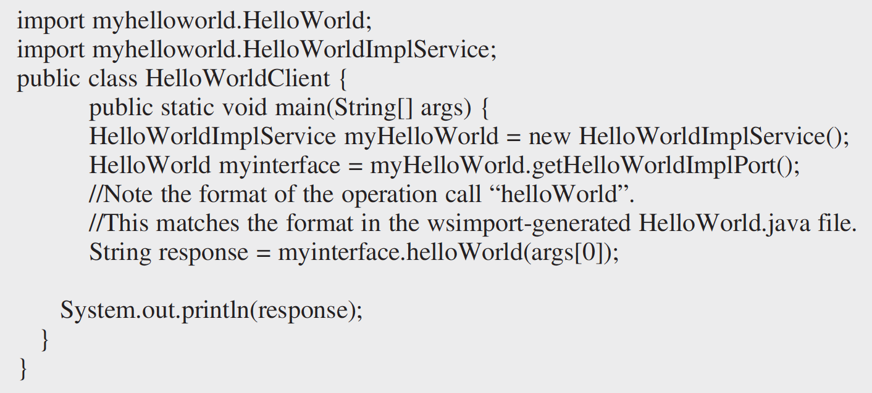
Non-REST (SOAP) Web Services
JAVA API FOR XML WEB SERVICES (JAX-WS)
wsimport -keep http://localhost:8080/hello?wsdl -d .
Creating client with wsimport
Client Stub

Slide 13
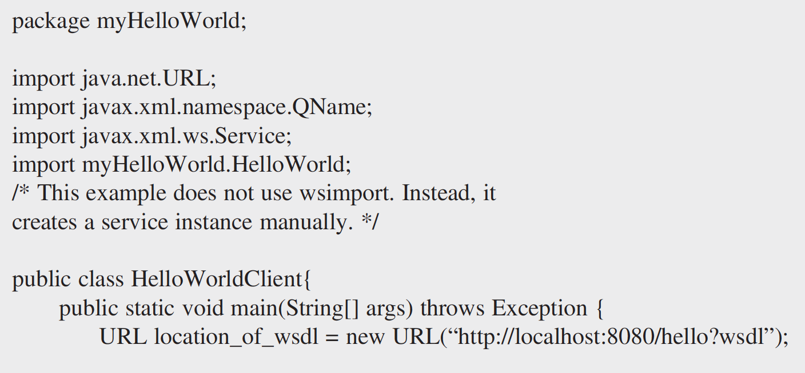
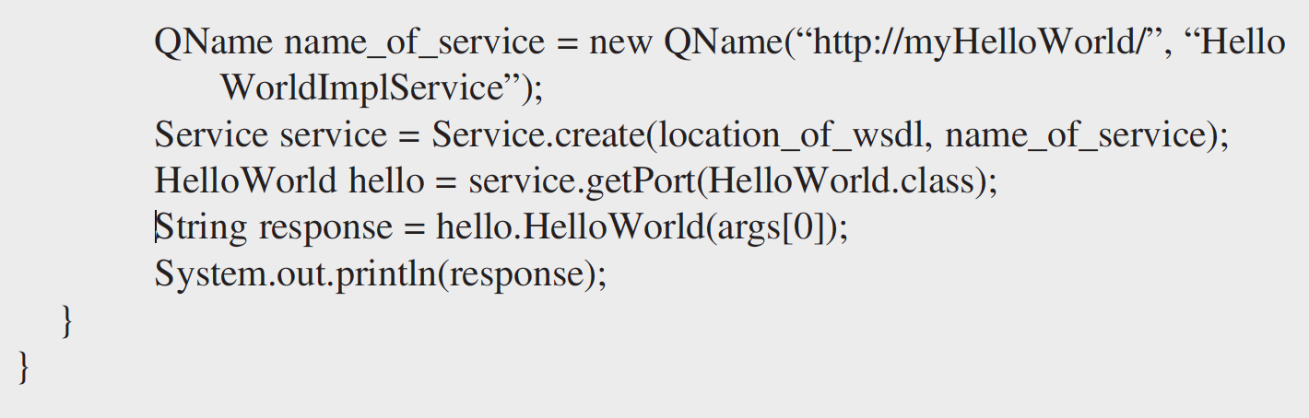
Non-REST (SOAP) Web Services
JAX-WS – Client code
Dynamic Proxy Client

Slide 14
Thank You!
In our next session:
RESTful Web Services

